Slide 1
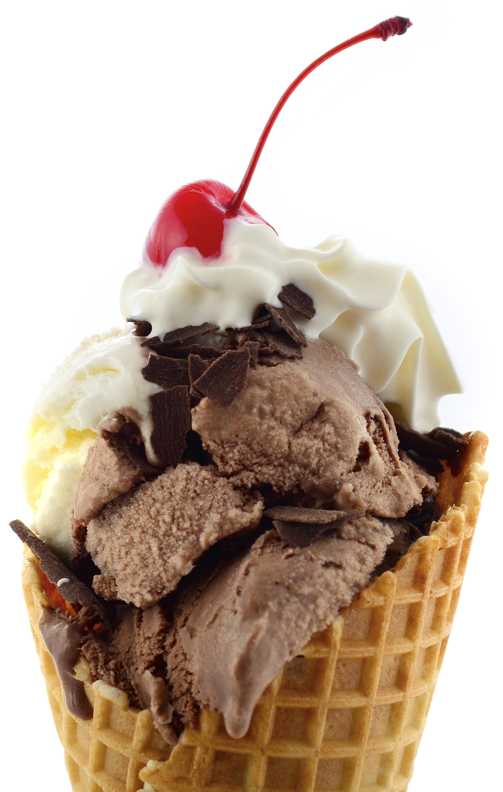
Exercise 4: More Chocolate

Slide 2
Exercise 4: More Chocolate
https://github.com/topherCantrell/class-HTMLCSS/tree/master/Exercise4
Modify Kayleigh’s recipes to list the ingredients for a recipe in a box to the right of the main content.
Use your own files from the previous exercise or download the previous solution:
https://github.com/topherCantrell/class-HTMLCSS/tree/master/Exercise3/solution
Give each page a stylish header and footer.

Slide 3
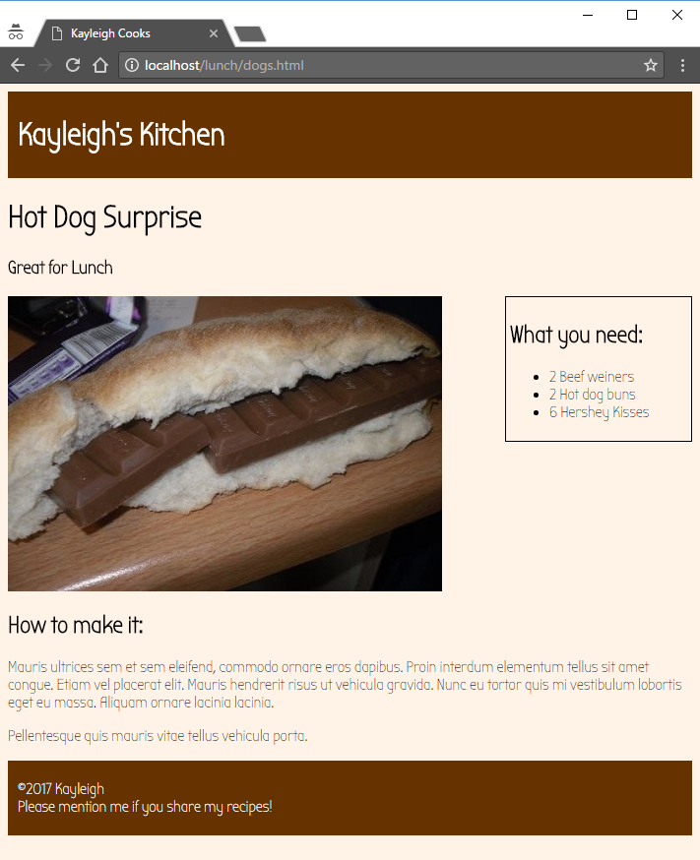
Here is a simple example.
It needs a lot of enhancements!
How about a logo?
How about styling the ingredients?
How about some styles in the footer?

